Slide 1
AI 620 EMERGING TOPICS IN ARTIFICIAL INTELLIGENCE
Module 3
Speech-to-Text and Text-to-Speech with Amazon Transcribe and Polly

Slide 2
Learning outcomes
Performing speech-to-text with Amazon Transcribe
Performing text-to-speech with Amazon Polly
Building serverless AI applications with AWS services, RESTful APIs, and web user interface
Reusing existing AI service implementations within the reference architecture
Discussing user experience and product design decisions

Slide 3
The architecture of universal translator
The Universal Translator will provide a web user interface for the users to record a phrase in one language and then translate that phrase to another language.

Slide 4
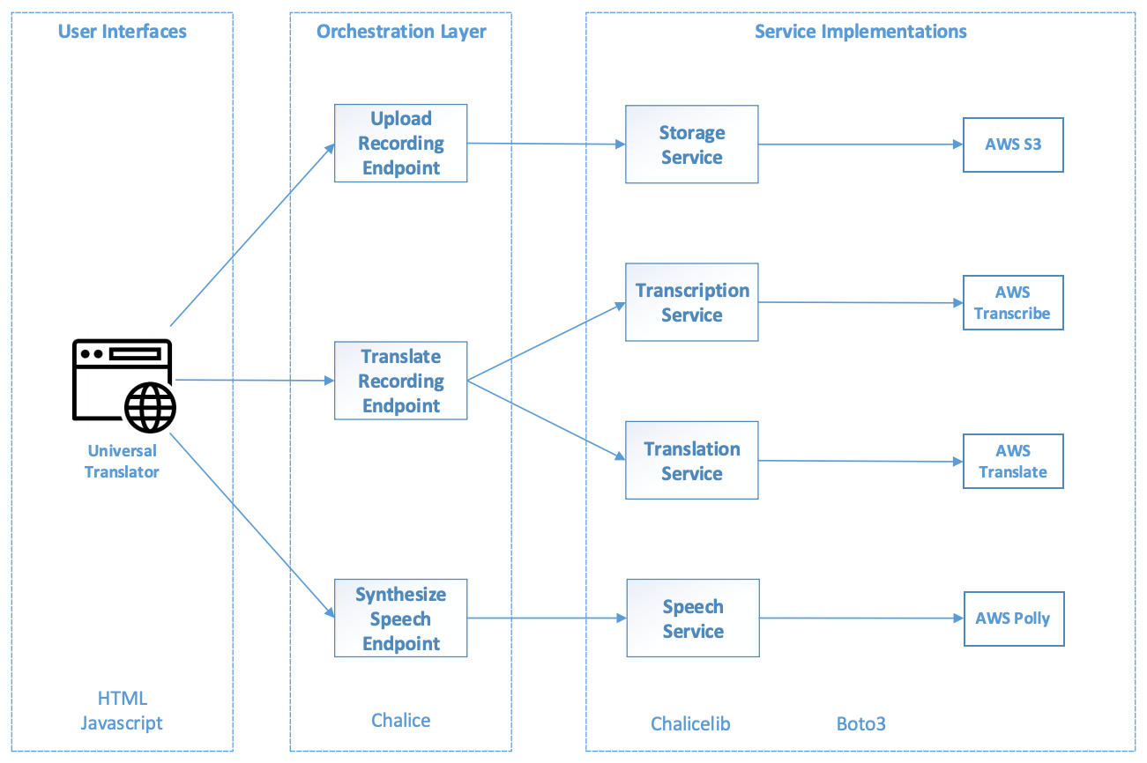
THE ARCHITECTURE OF UNIVERSAL TRANSLATOR

Slide 5
3 restful endpoints
Upload Recording Endpoint
Delegate the audio recording upload to our Storage Service, which provides an abstraction layer to AWS S3.
Translate Recording Endpoint
Use both the Amazon Transcription Service and the Amazon Translation Service.
First gets the transcription of the audio recording, and then translates the transcription text to the target language.
The transcription service and the translation service abstract the Amazon Transcribe and Amazon Translate services respectively.
Synthesize Speech Endpoint
Delegate the speech synthesis of the translated text to the Speech Service, which is backed by the Amazon Polly service.

Slide 6
Reusable services
The Translation Service is reused from the Pictorial Translator project.
The upload file method in the Storage Service implementation is also reused from the previous projects.

Slide 7
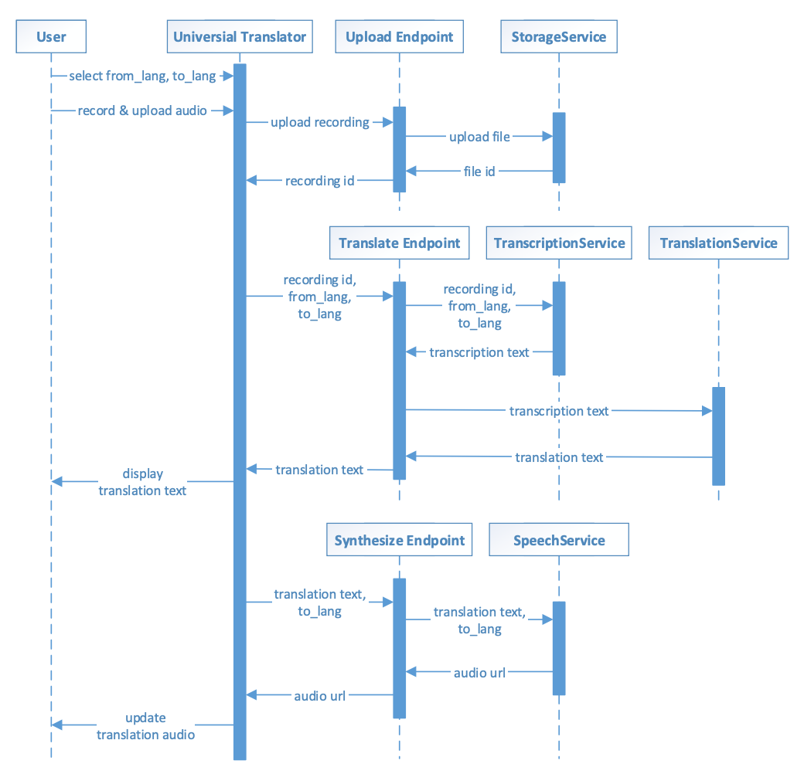
Component interactions of universal translator

Slide 8
End-to-end translation process
Three major steps
Upload the audio recording
Get the translation text
Synthesize the speech

Slide 9
Design Decision
Above design decision allows the Universal Translator to display the translation text in the web user interface while the translation audio is being synthesized.
This way, not only does the application appear more responsive to the user, but the user can also make sue of the translation text in certain situations without waiting for the audio synthesis.

Slide 10
Implementing the project
PE03-1
Setting up the project structure
Follow textbook page127 step 1 to 6
PE03-2 Implementing services
2.1 Transcription service – speech-to-text
2.2 Translation service – translating text (Same as PE02)
2.3 Speech service – text-to-speech
2.4 Storage service – uploading and retrieving a file (Similar to PE02)

Slide 11
About 2.1 transcription service
We are going to translate spoken words from one language to another in the Universal Translator.
Knowing which words were spoken is the first step of the translation process. To do so, we are going to use the Amazon Transcribe service.
To generate text from speech, Amazon Transcribe uses deep learning based Automatic Speech Recognition (ASR) algorithms.

Slide 12
Asynchronous pattern in transcript service
It's asynchronous pattern which is commonly used for longer running processes.
Instead of blocking the API caller until the process is completed, it allows the caller to perform other tasks and check back on the process later.
Think about the customer experience of ordering an item on Amazon.com.
Instead of making the customer wait on the website for the item to be packaged, shipped, and delivered, the customer is immediately shown the confirmation message that the order has been placed, and the customer can check on the order status (with a unique order ID) at a later time.

Slide 13
About 2.3 Speech service
Once we have the translation text, we are going to leverage the Amazon Polly service to generate a spoken version of the translation
The Amazon Polly service follows a similar asynchronous pattern we saw earlier with Amazon Transcribe
The speech and transcription services shielded all these implementation details from the rest of our application. In the event that we want to swap in a different speech or transcription service implementation, the changes are isolated in the service implementation layer

Slide 14
IMPLEMENTING THE PROJECT
PE03-3 Implementing RESTful endpoints
3.1 Translate recording endpoint
3.2 Synthesize speech endpoint
3.3 Upload recording endpoint (Similar to PE02)
PE03-4 Implementing the web user interface
Index.html + scripts.js
PE03-5 Deploying Pictorial Translator to AWS (Similar to PE02)
DONE!

Slide 15
About 3.1 translate recording endpoint
It's an HTTP POST endpoint that takes JSON parameters in the request's body.
This endpoint takes the recording ID as a parameter, and uses a JSON body to pass in the source and target languages of the translation.

Slide 16
About synthesize speech endpoint
The Synthesize Speech endpoint is an HTTP POST endpoint that takes JSON parameters in the request’s body.
The endpoints utilizes JSON to pass in the target language and the text to be converted into speech.
Although Universal Translator is designed to translate short phrases, the text used to perform text-to-speech on can be long, depending on the application.
Due to a limit to the length of URLs, we are using a JSON payload here rather than URL parameters.
This design decision makes the endpoint more reusable for other applications in the future.
It is also a good practice to keep the URLs of your application clean and short.

Slide 17
About 4 Implementing the web user interface
Only one translation can be performed at a time. In other words, we made the design decision to treat the steps of every translation as sequential.
Mainly due to the speed of Amazon Transcribe and Amazon Polly services, there is a specific amount of waiting time for each end-to-end translation.
There are few techniques to improve the user experience during the wait time.

Slide 18
References
Tripuraneni, S., & Song, C. (2019). Hands-On Artificial Intelligence on Amazon Web Services. Packt Publishing. https://learning.oreilly.com/library/view/hands-on-artificial-intelligence/9781789534146/

